Slide 2
“I shall not be moved.”
Psalm 16:7,8

Slide 3
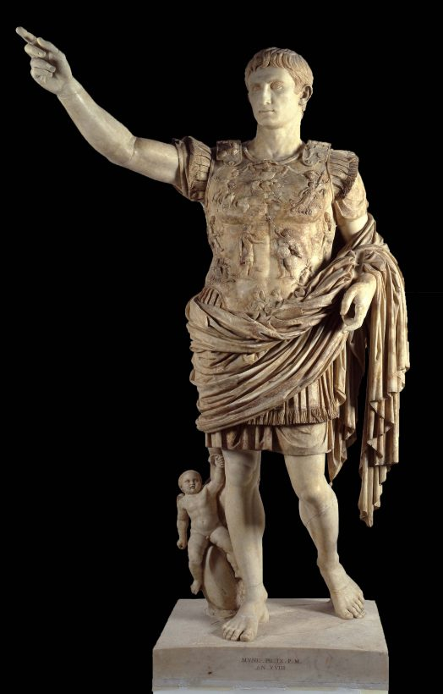

Fully armed warrior has weapon in right hand and shield in his left.
The person to the right of a king would have the privilege of defending him

Slide 4
The Lord take up His position at someone’s right hand…
He is in a position to offer defense with His shield – Psalm 109:31
Psalm 62:5,6 “He only is my rock and my salvation; He is my defense; I shall not be moved.”
You
The
Lord

Slide 5
HE LISTENED TO THE LORD’S COUNSEL
Psalm 16:7 “the Lord who as given me counsel”
His Refuge- Psalm 16:1 “in You I put my trust”
His Highest Good – Psalm 16:2 “My goodness is nothing apart from You”
His Choice Portion- Psalm 16:5 “You are the portion of my inheritance”
His Heart Instructs him during the night – Psalm 16:7b; 1:2,3

Slide 6
The wisdom that is from above
James 3:17 Divine wisdom from God
False, Sensual wisdom – James 3:15
It is PURE --- The Other is SENSUAL
It is PEACEABLE --- The Other is full of STRIFE
It is GENTLE --- The Other is overbearing, self-seeking

Slide 7
The wisdom that is from above
It is EASY TO BE ENTREATED --- The Other is obstinate, incapable of persuasion
It is FULL OF MERCY –-- The Other is unforgiving, unkind
It is FULL OF GOOD FRUITS --- The Other evil fruits
It is WITHOUT PARTIALITY --- The Other is a respecter of persons
It is WITHOUT HYPOCRISY --- The Other boasts and lies against the truth
LISTEN TO HIM – Proverbs 15:32,33; 18:15

Slide 8
None blessed who walk in counsel of the ungodly
Psalm 1:1
The godly do not: WALK, STAND or SIT in the way of the WICKED, way of SINNERS nor SIT in the SEAT OF MOCKERS!
Instead, they reflect on the Lord in their WALKING, STANDING and SITTING – Deuteronomy 6:7
When we QUIT listening to God, the inevitable will happen – we will FALL AWAY!

Slide 9
His conscience was clear
Psalm 16:7 “My heart also instructs me in the night seasons.”
His conscience told him he had done the right thing
Romans 2:14 “accuses or excuses"
Repeated violation of conscience will cause it to cease its proper function – 1 Timothy 4:2
1 John 3:21 - "our heart will not condemn us"

Slide 10
conscience isn’t a safe guide
Acts 24:16; 26:9 “a conscience without offense toward God and men..” “ I myself thought I must do many things contrary to the name of Jesus of Nazareth.”
Man’s Heart is Deceitful – Jeremiah 17:9,10
He Cannot Guide Himself – Jeremiah 10:23
Must ALWAYS LISTEN TO GOD’S COUNSEL!

Slide 11
Constantly kept god in his mind’s eye
Psalm 16:8 “ I have set the Lord always before me”
Sad when we are so caught up in the world’s activities that we never think of GOD except at the assemblies of the church!
Psalm 16:11 “show me the path of life; In Your presence is fullness of joy”
Matthew 10:28-31 “the very hairs of your head are all numbered.”
We cannot treat God Casually, Contemptibly or Carelessly- Isaiah 26:8,9

Slide 12
“we shall not be moved”
1 Corinthians 15:58 NKJV 58 “Therefore, my beloved brethren, be steadfast, immovable, always abounding in the work of the Lord, knowing that your labor is not in vain in the Lord.”
Galatians 6:9 NKJV 9 “And let us not grow weary while doing good, for in due season we shall reap if we do not lose heart.”

